Slide 1

Home Credit Default Risk Analytics
Big Data Project:
Hadoop
Hive
Zeppelin (Spark, SQL)
HBase
Presented by:
Tarun Kataria
Notes:
Hi guys my name is Tarun Kataria. I will present our analysis of the Kaggle competition Home credit default risk. So its the analysis of credit loan applications provided by Home credit.

Slide 2
Table of Contents
Our business Case
Data Sets
HDFS
HIVE
HBASE
ZEPPELIN QUERIES
Analysis of Sample queries
conclusion
Notes:
The Agenda for today presenting our business case, going through the Hadoop stack so HDFS, HIVE, Hbase then our Zeppelin queries with our analysis. Then our conclusion to our analysis

Slide 3


Business Case
The dataset is from Home credit
Non banking financial institution
Based in the Czech Republic
Firm’s prime market
Eastern Europe
East & south east Asia
Dataset is from a Kaggle Competition
Prize $70,000
Notes:
Here is a brief background of the business we have chosen

Slide 4

Business Case
Business Questions
Family status of the loan applicants?
Occupation of the loan applicant ?
Education of the loan applicant?
Is it possible to predict how capable each applicant is with repaying a loan?
Notes:
Many citizens are denied credit loans due to bad or no credit history. These citizens unfortunately will look to unreliable lenders. Home credit group wants to change by expanding their financial services to those who are unable to access financial service. While Home credit is using Machine learning algorithms the company has challenged Kagglers to unlock their true potential.

Slide 5
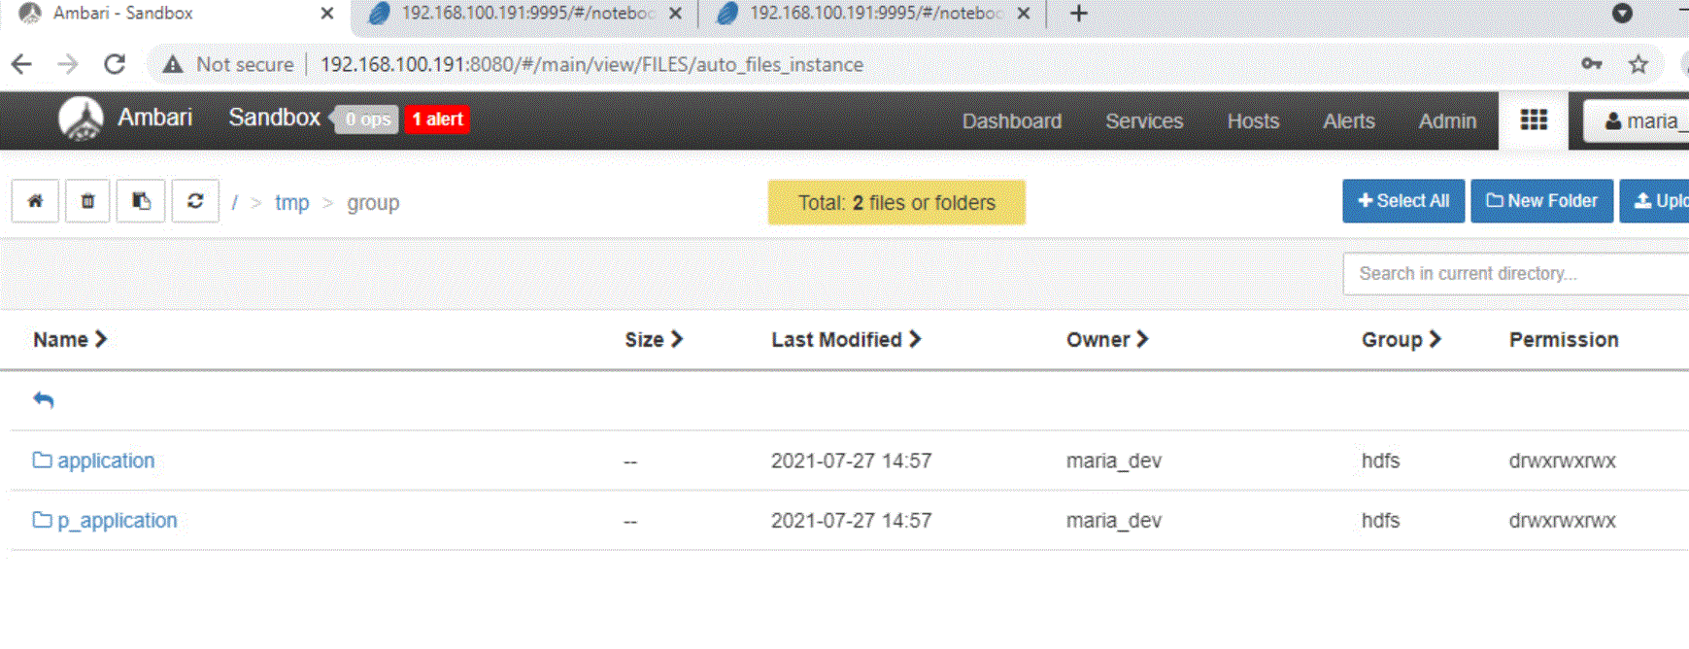
HDFS
Notes:
In HDFS, in the temp folder we made 2 folders as application and p_application

Slide 6
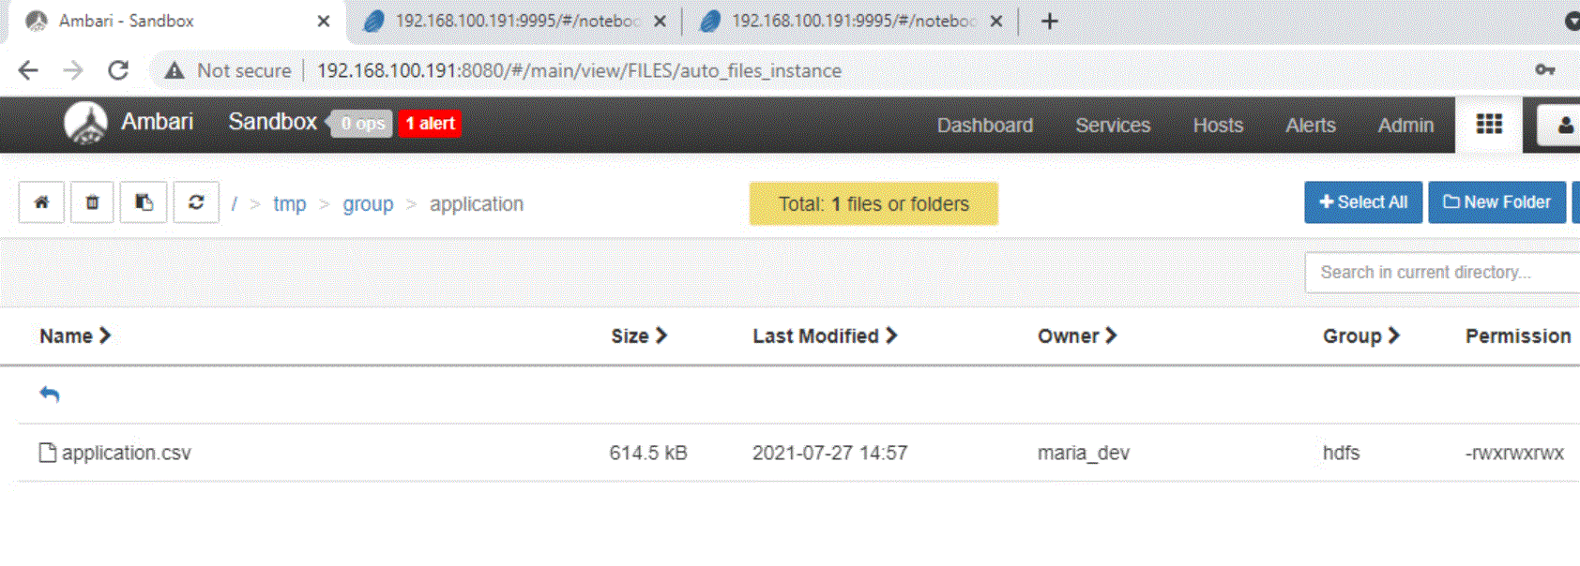
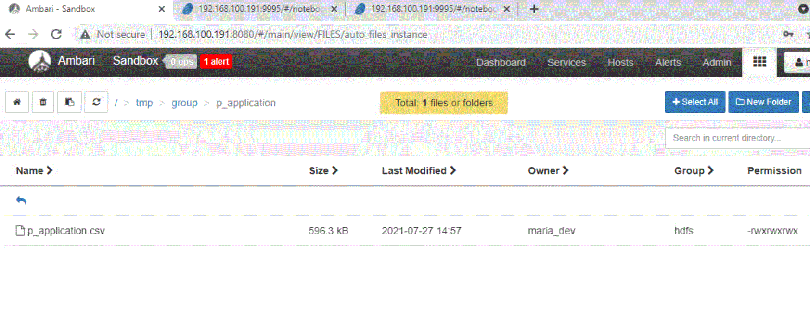
HDFS
Notes:
Here each csv is in their respective folder so application csv is in application folder and P_application csv in the P_application

Slide 7
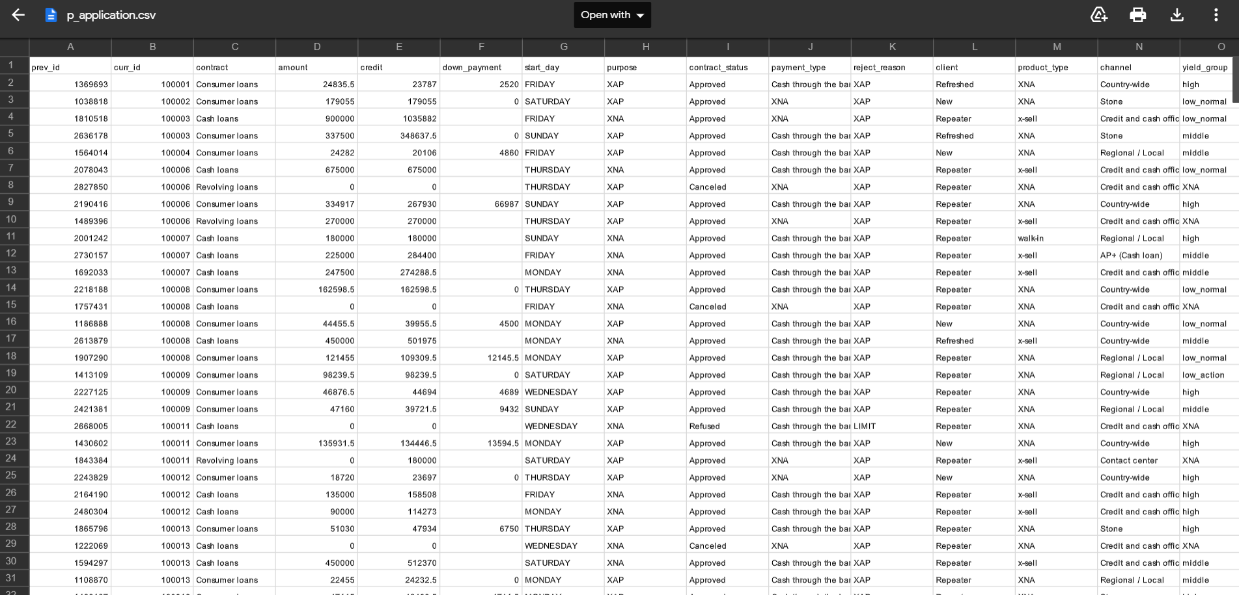
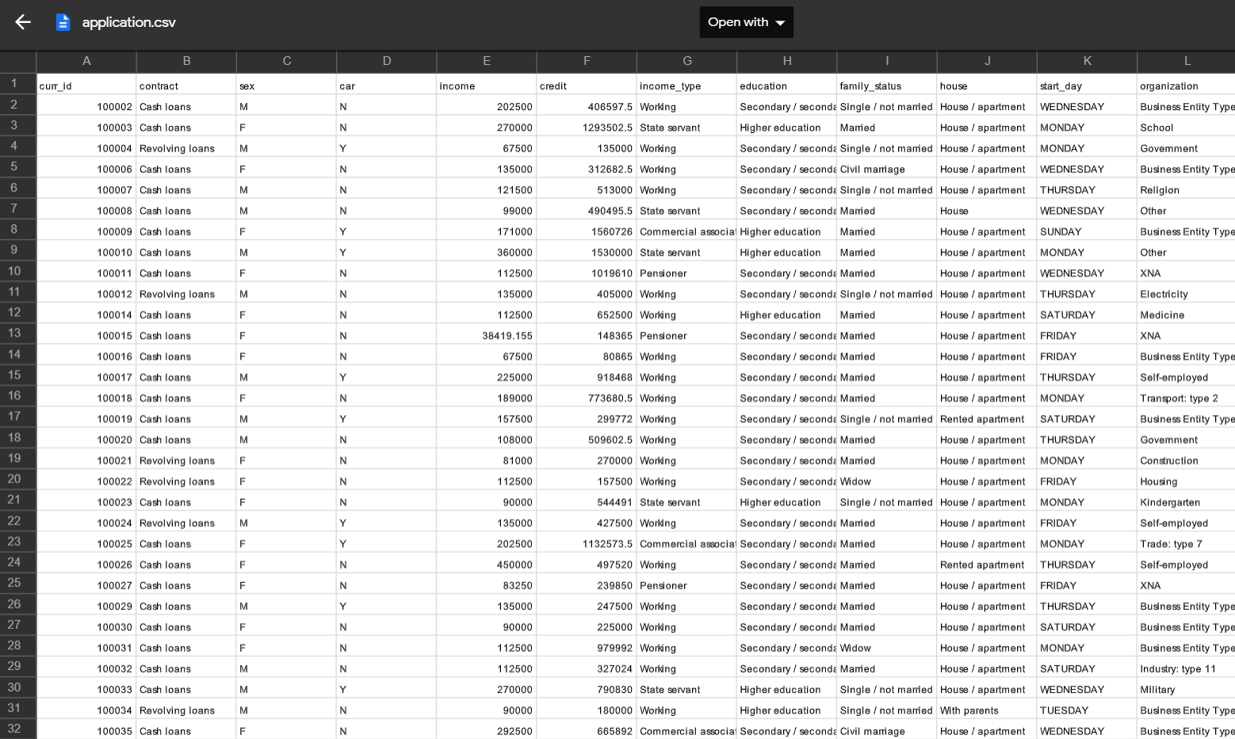
Datasets
Notes:
These datasets are sourced from Kaggle.com
Here are the 2 CSV files mentioned earlier Application and P_application. We will analyze why certain individuals are denied credit from there current or previous loan application. Also what type of people get accepted for their loan application regarding their income, education and type of work and more other variables to analyse with our project

Slide 8
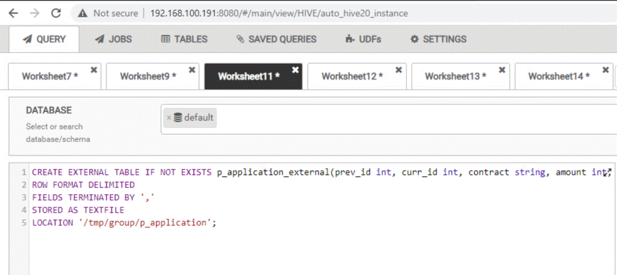
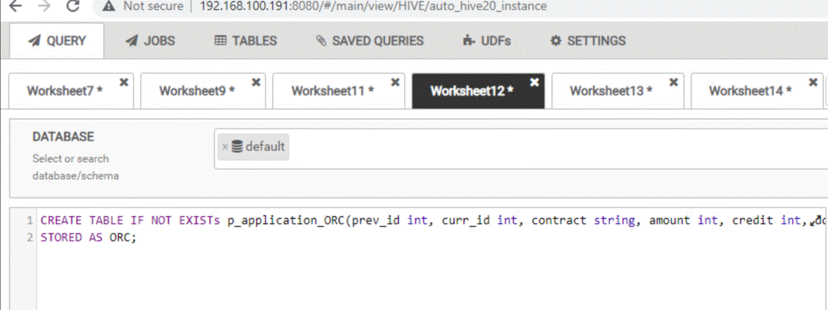
Hive
External table
Internal table
Notes:
We have created hive external and internal table for our application and previous application dataset. We named them as application_external & application_orc and p_application_external and p_application_orc.

Slide 9
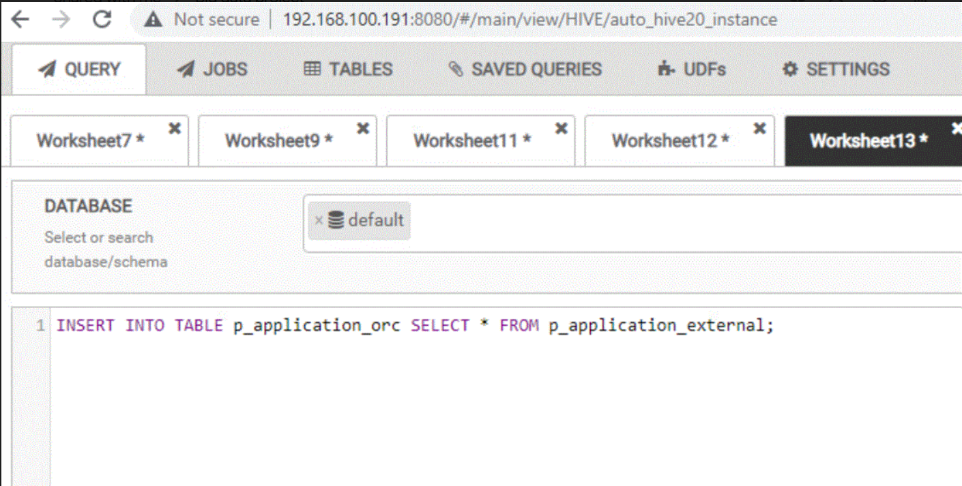
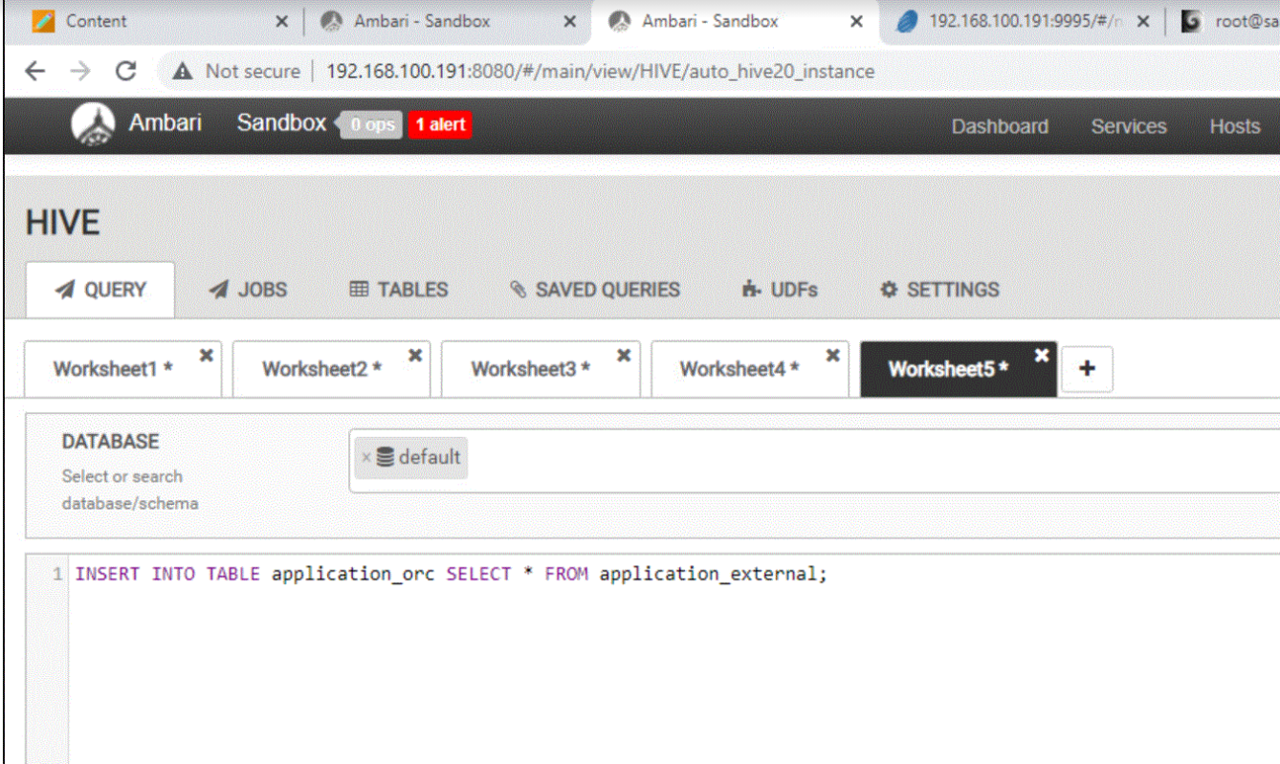
Hive - Loading the data
Notes:
Loading the data from external table to internal table for both application and p_application data sets.

Slide 10
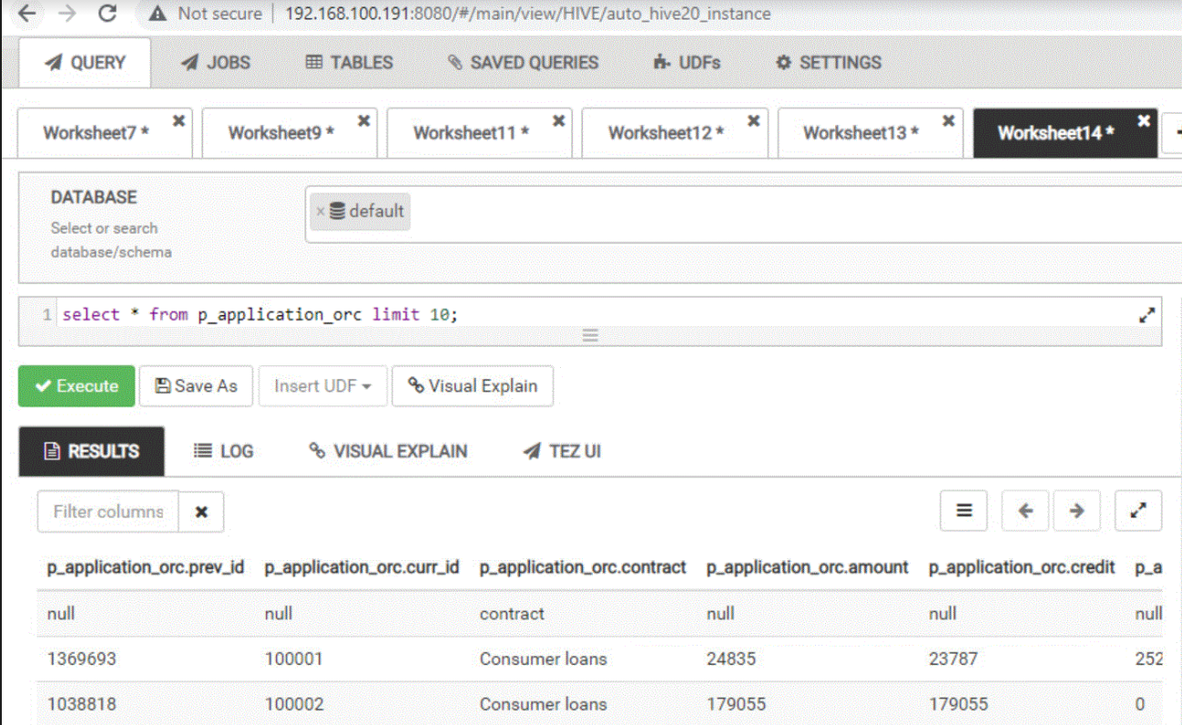
Hive: Select All statements
Notes:
To show the data from external and internal table we selected all from external and internal table and in the slide you can see the data have been pulled out and shown as results.
Here is the select statement for p_application for the previous loan

Slide 11
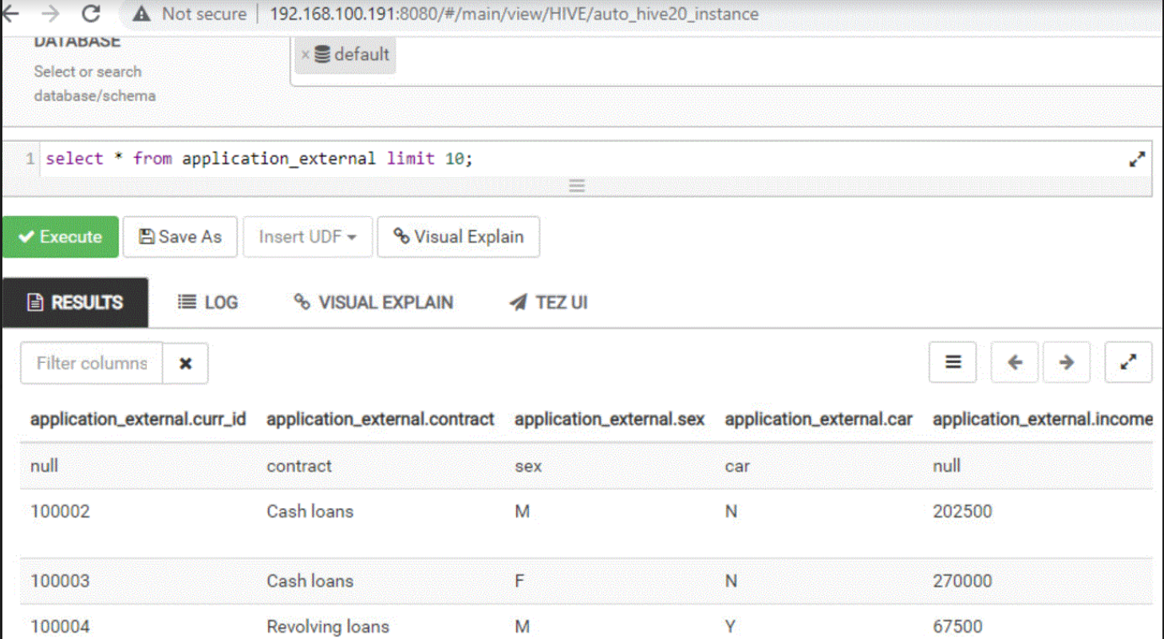
Hive - Printing
Notes:
Here is the select statement for current loan application Application_external

Slide 12
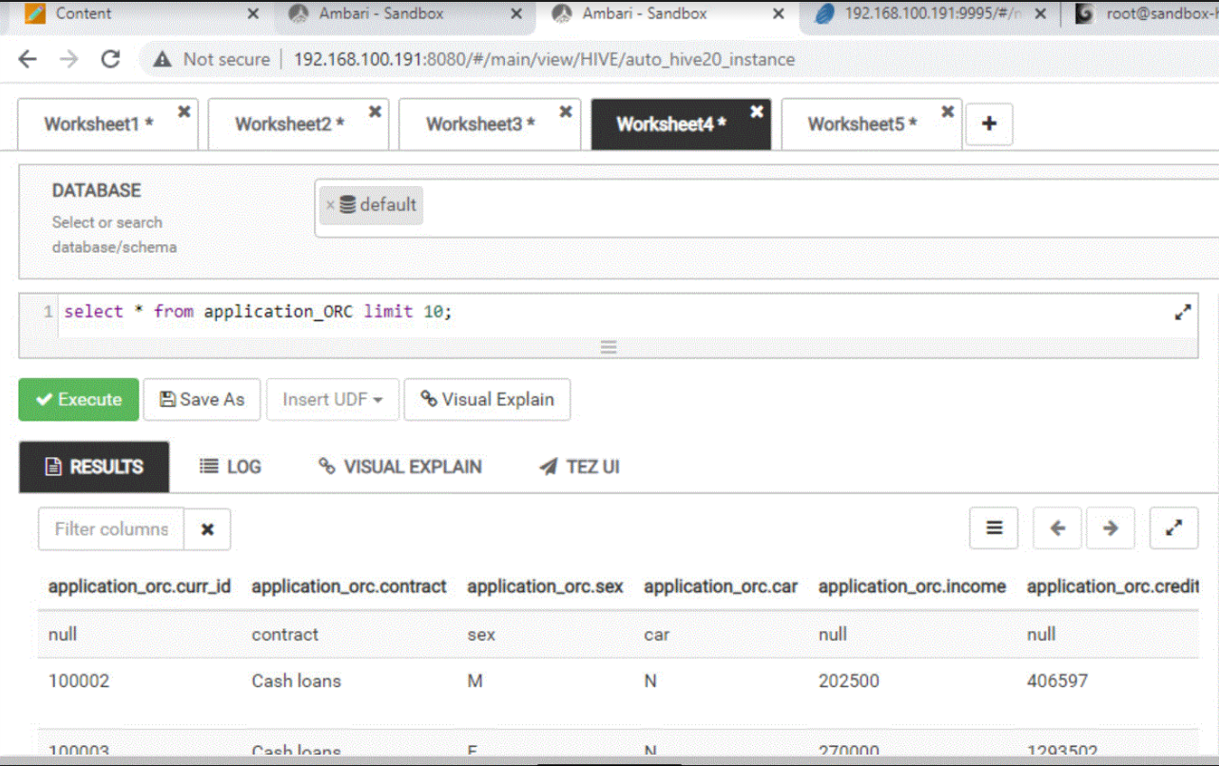
Hive - Printing
Notes:
Here is the select statement for the current application for the current loan Application_ORC

Slide 13
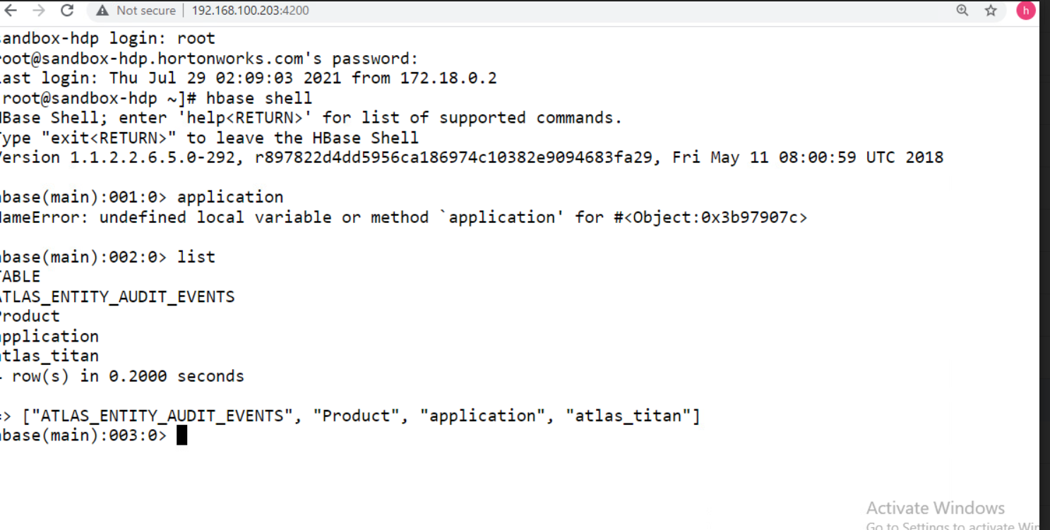
Hbase

Slide 14
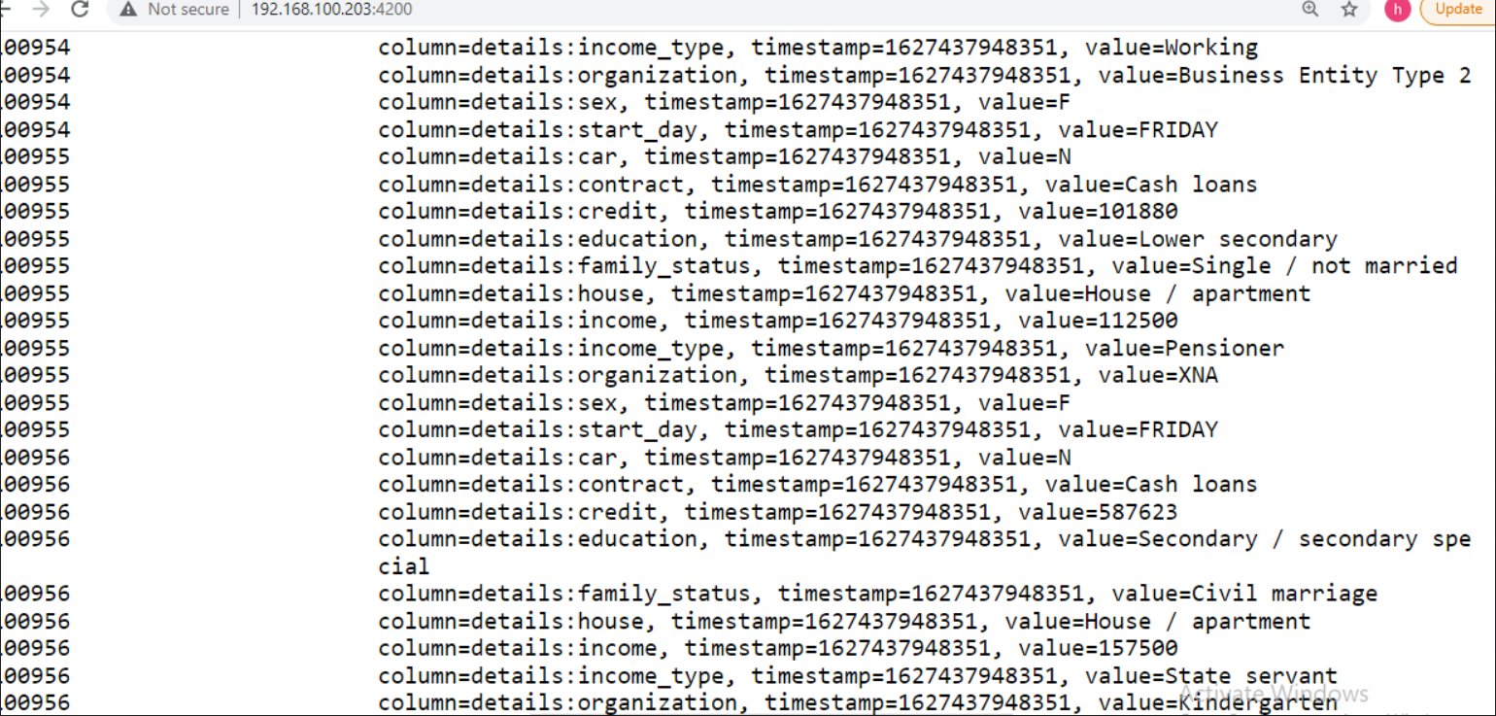
Uploading the data to Hbase

Slide 15
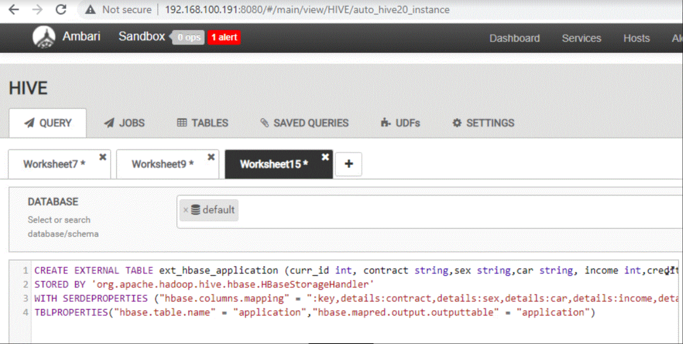
Hbase - Table creation
Notes:
Here is where we create the external table so we link this data from hive to hbase.

Slide 16
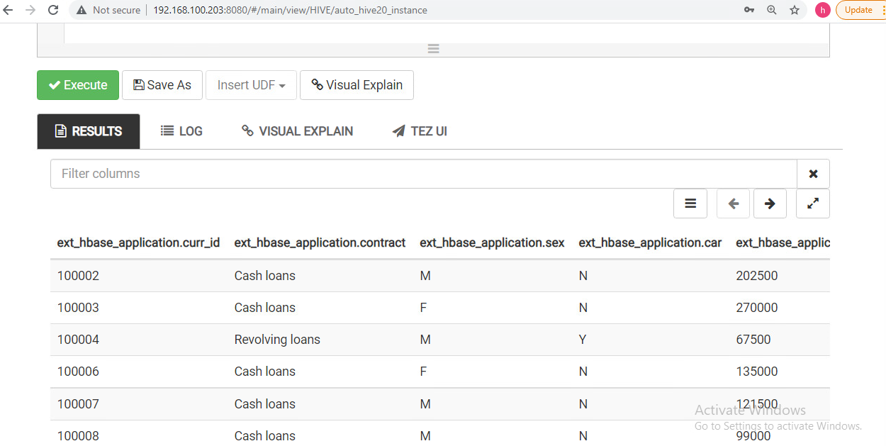

Slide 17
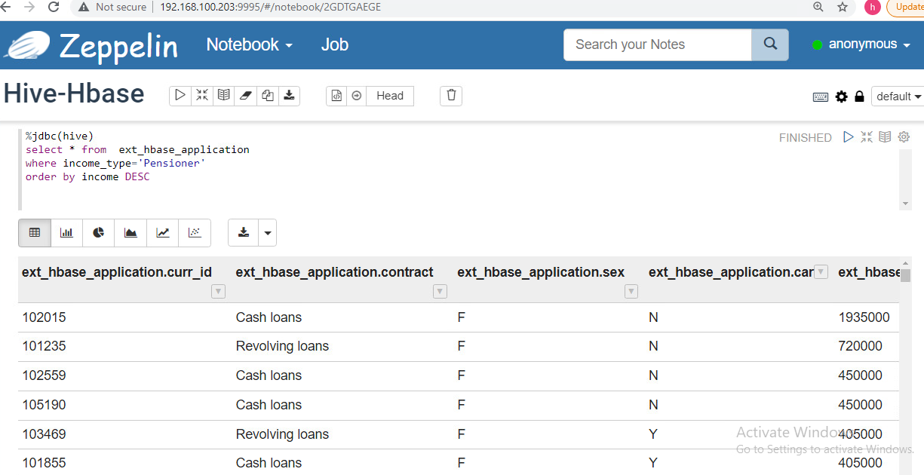

Slide 18
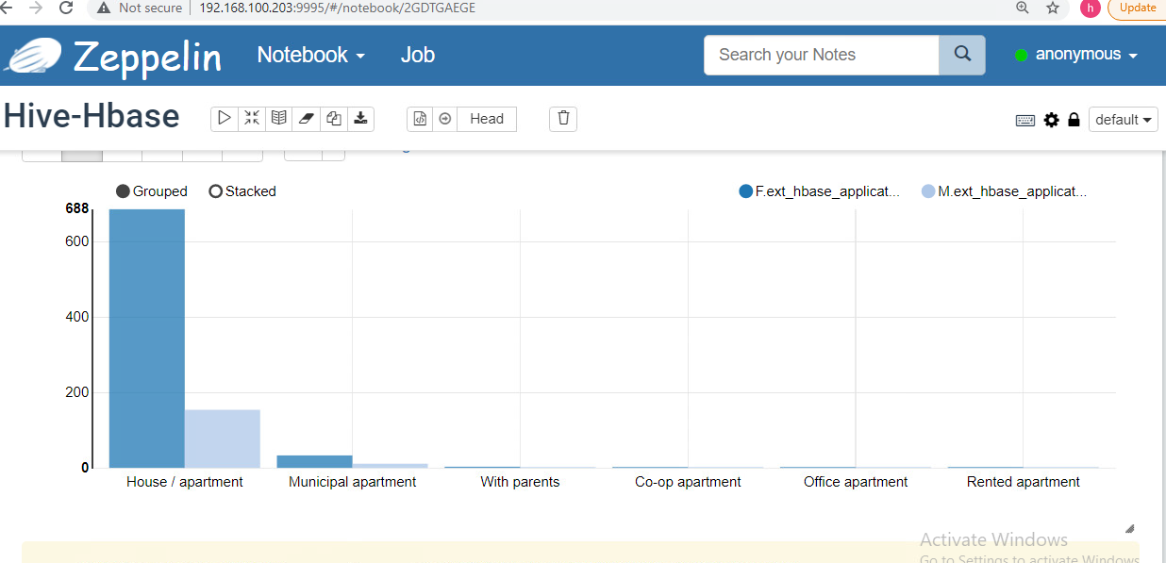

Slide 19
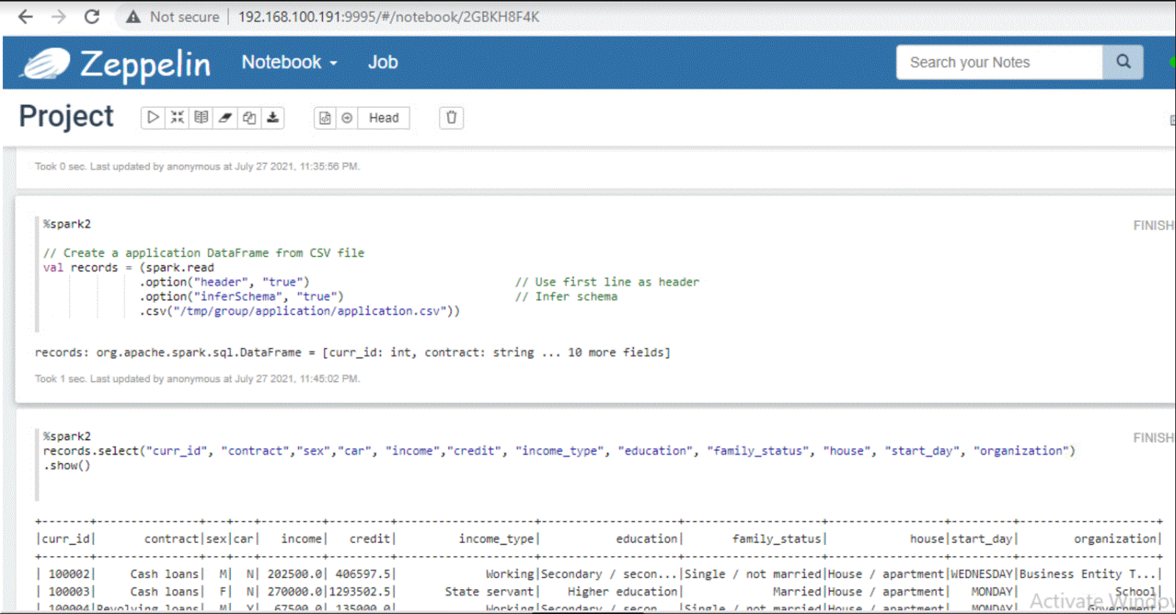
Zeppelin - Creating dataframes and loading the data
Notes:
Here we have loaded the data frame

Slide 20
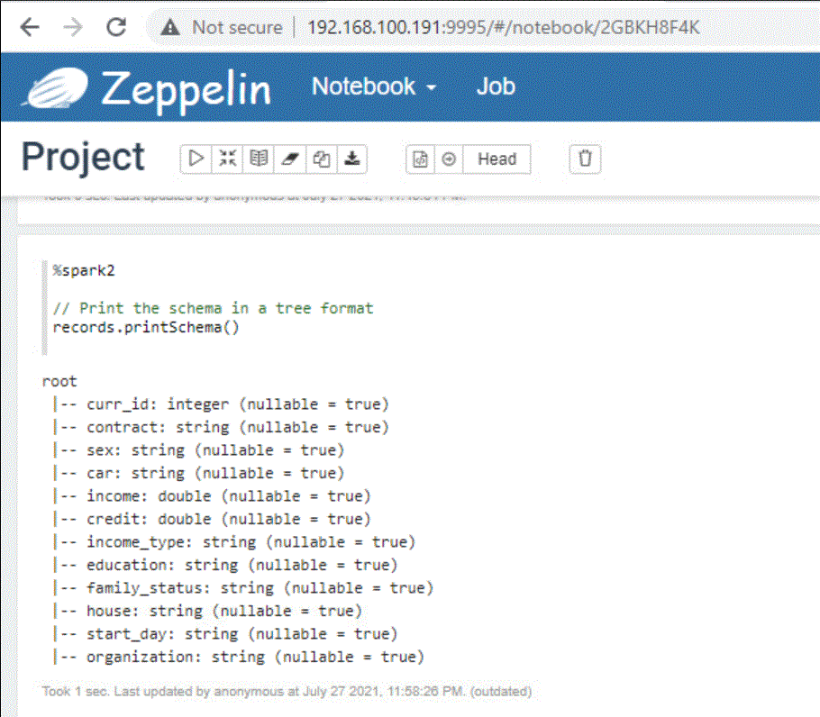
Print Schema

Slide 21
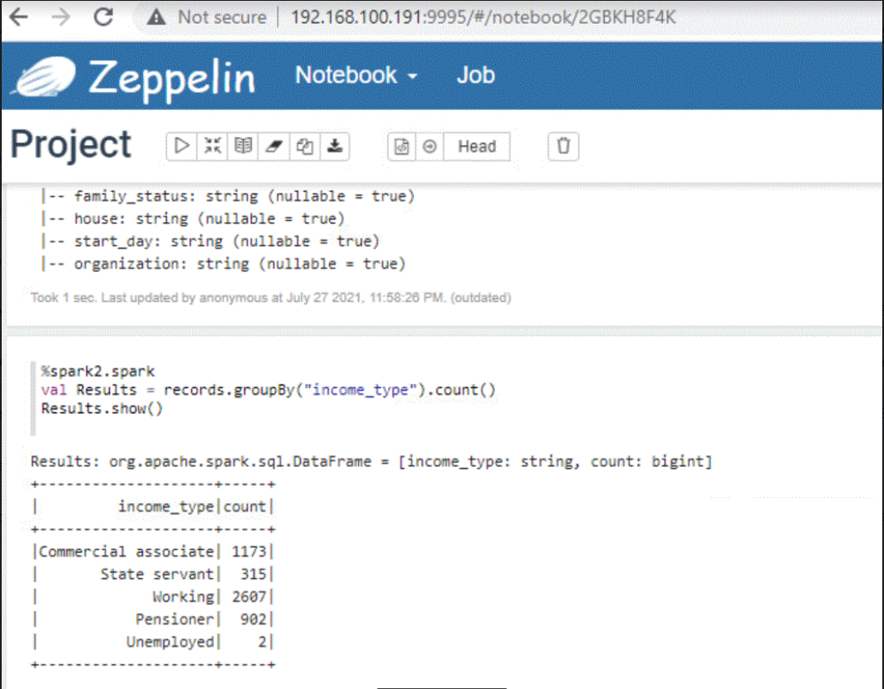
Zeppelin - Data grouped by income type
Notes:
With Spark, we can show the counting of income_type. We did that using group by income type and we put the value in results.

Slide 22
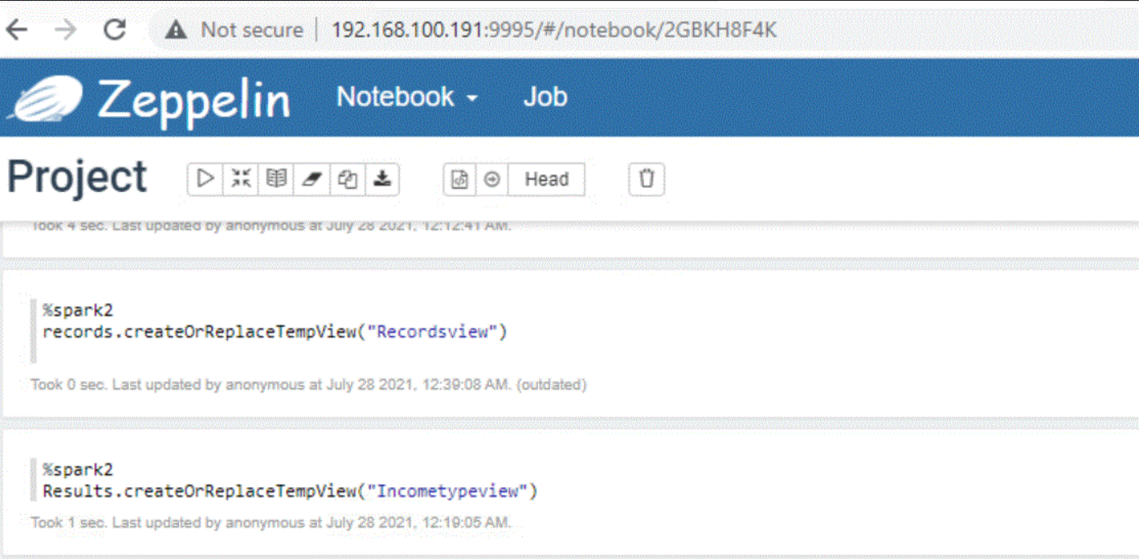
Zeppelin - Creating tempview tables
Notes:
We created Recordsview and Incometypeview to be able to run SQL on the two temporary tables and visualized necessary figures. Now let’s do it in more details with SQL.

Slide 23
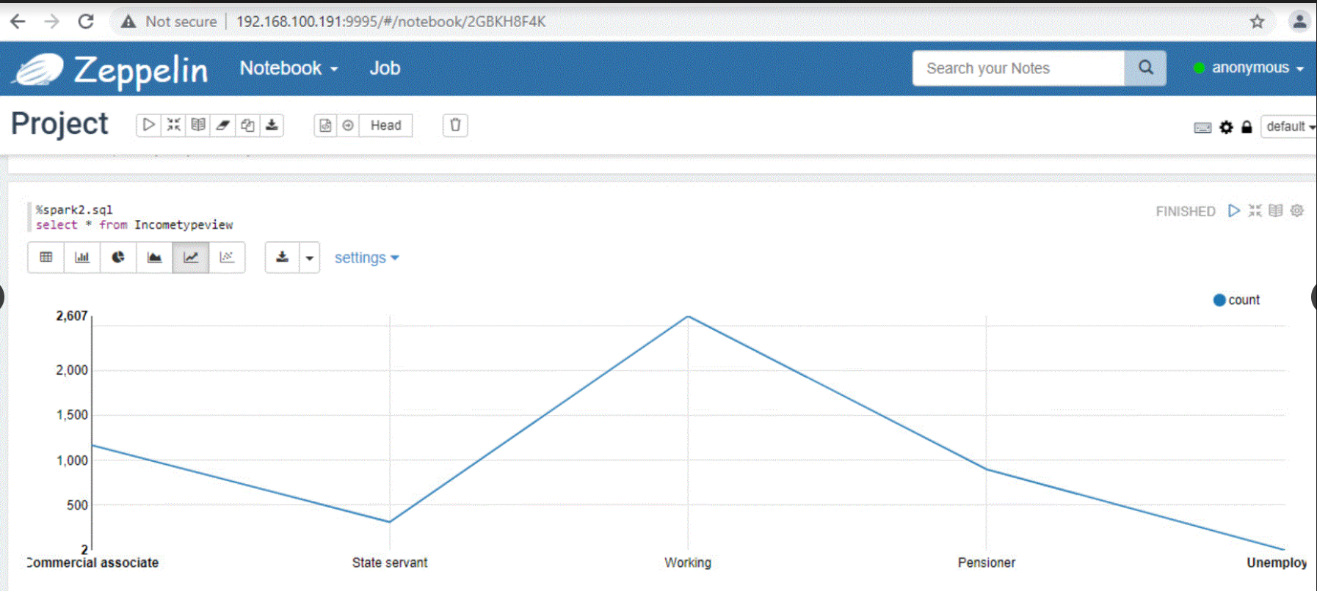
Income Type’s Line chart
Notes:
Now let’s do it in more details with SQL.

Slide 24
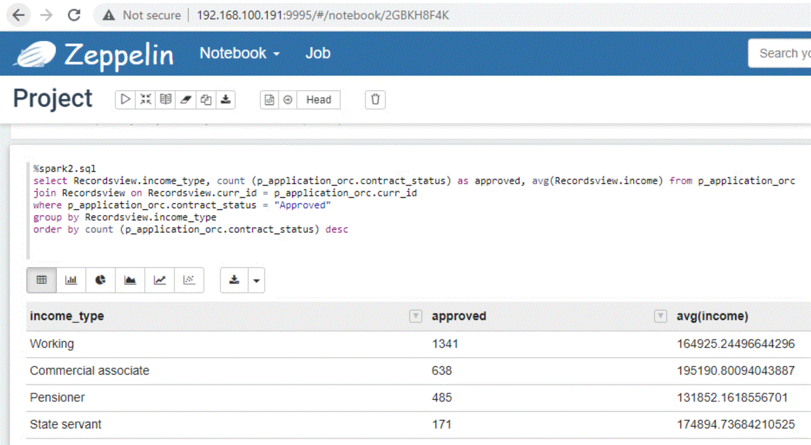
Which income type of applicants got the most loan approvals? What was their average income in approved case?
Notes:
Which income type of applicants who got approval for a loan?
Our table illustrates that Working people received the most loan approval by 1341 ( 50.8 % of income type) while their average income ranked 3rd by near 165 thousand (24.2%). Meanwhile, Commercial associate obtained the 2nd highest approvals for loan while their average income placed the highest by more than 195 thousand. Pensioner and State servant were among the lowest cases of approved applicants.

Slide 25
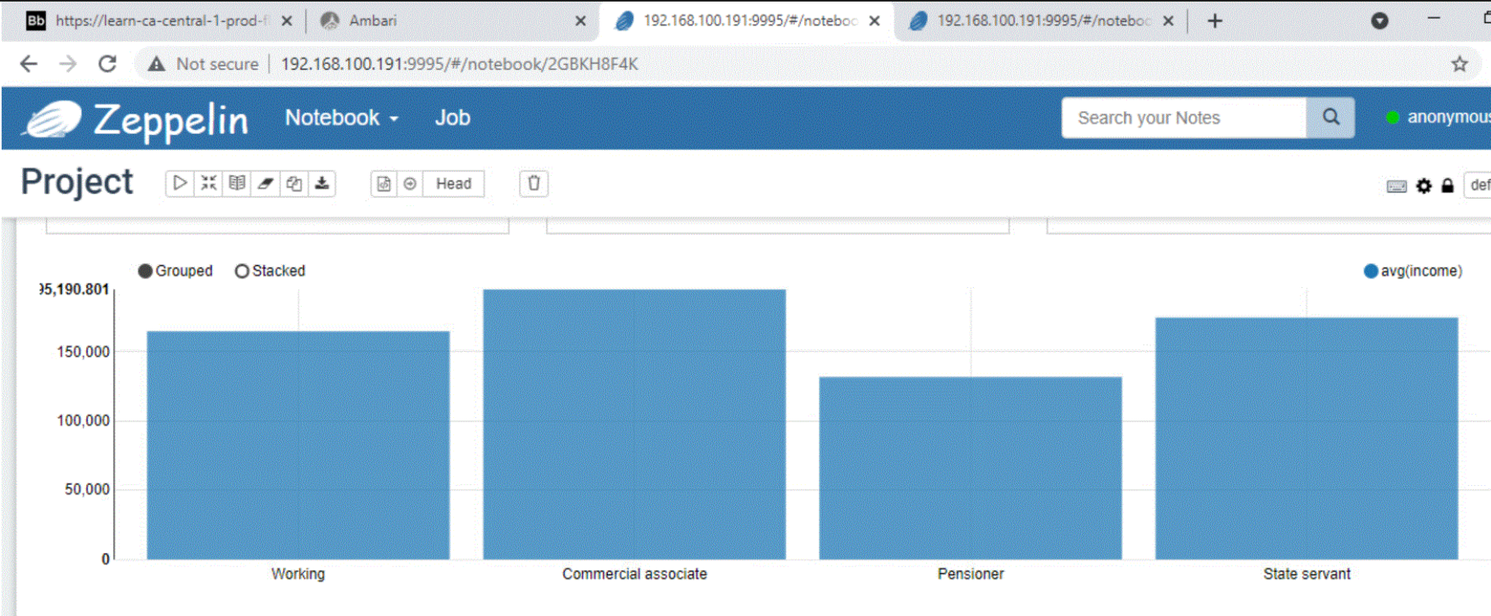
Loan Approvals: Average income for each income type

Slide 26
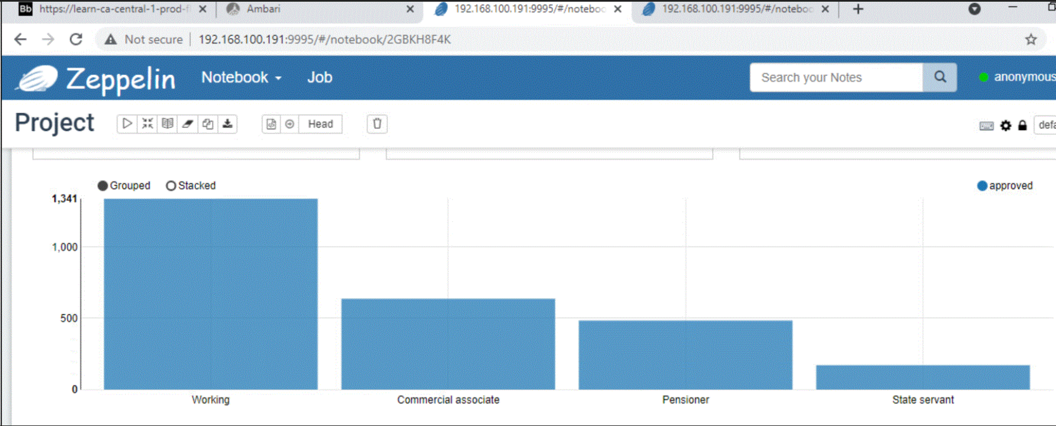
Loan Approval’s Bar chart by Income Type
Notes:
For the cases of Approved , Working income_type dominated the largest portion with 1341 cases while commercial associate kept their position at the 2nd rank, pensioner and state servant still placed the 3rd and 4th.

Slide 27
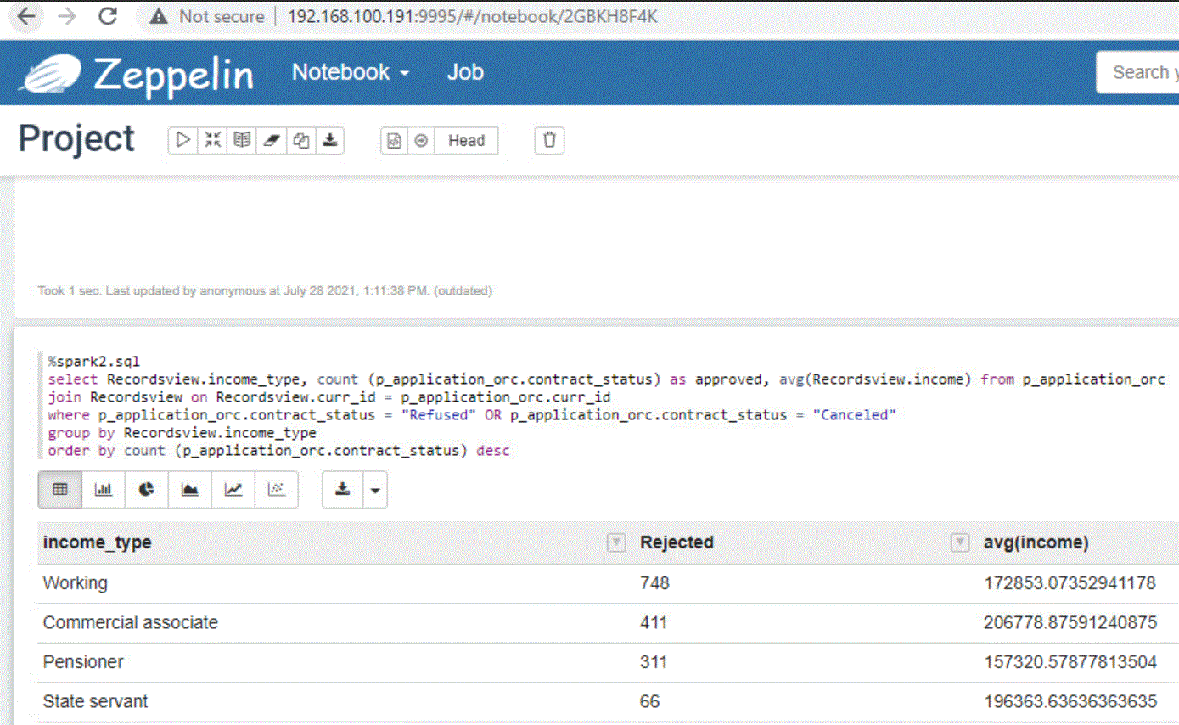
Which income type got the most loan rejection? What was their average income in rejected case?
Notes:
Which income type of applicants who got rejected for a loan?
Working dominated this field with the highest case of rejected applicant for a loan (748) although their average income ranked 3rd by slightly more than 172 thousand of application who got rejected.
Commercial got the second highest case by 411 while taking the 1st place of average income by more than 206 thousand.
Pensioner and State servant were among the lowest cases of rejected applicants but State Servant (ranked last) obtained the 2nd highest average income by more than 196 thousand.

Slide 28
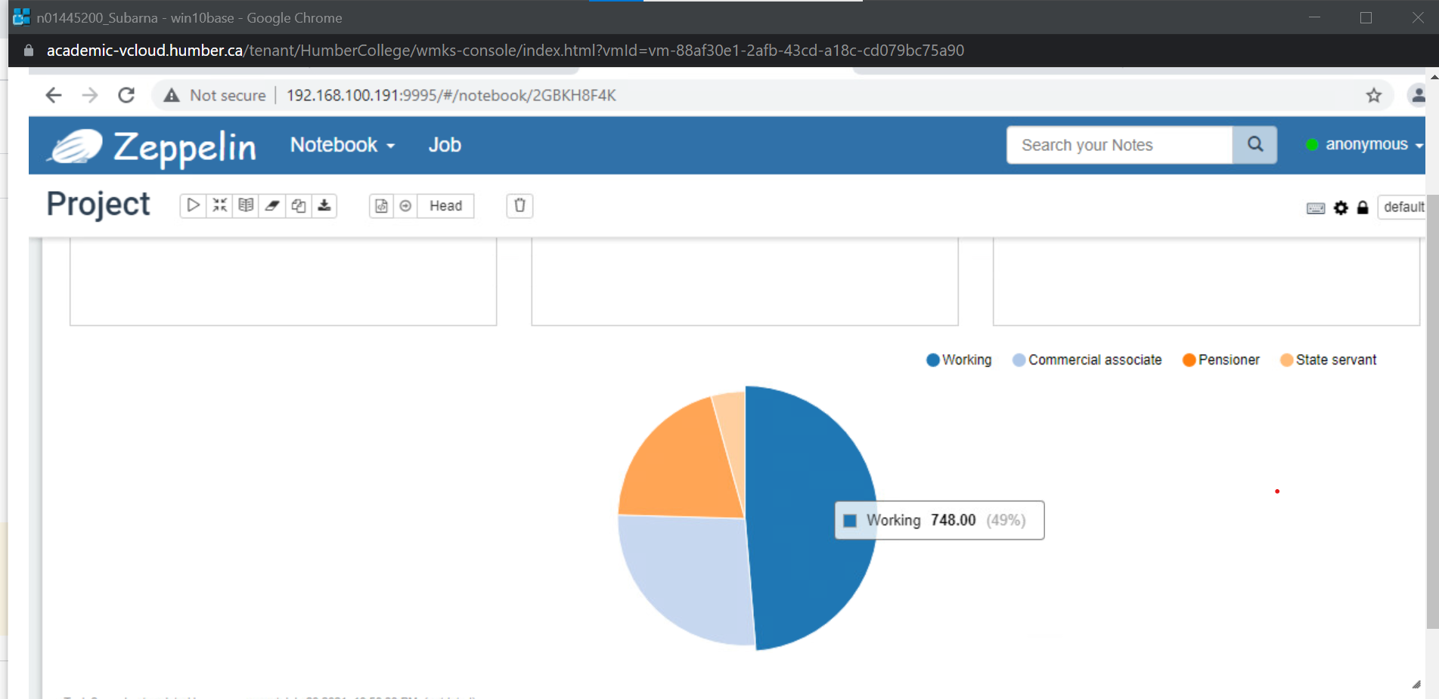
Notes:
This is a pie chart we had visualized so you can see the working type dominates roughly half of the applicant with income type rejected for a loan.

Slide 29
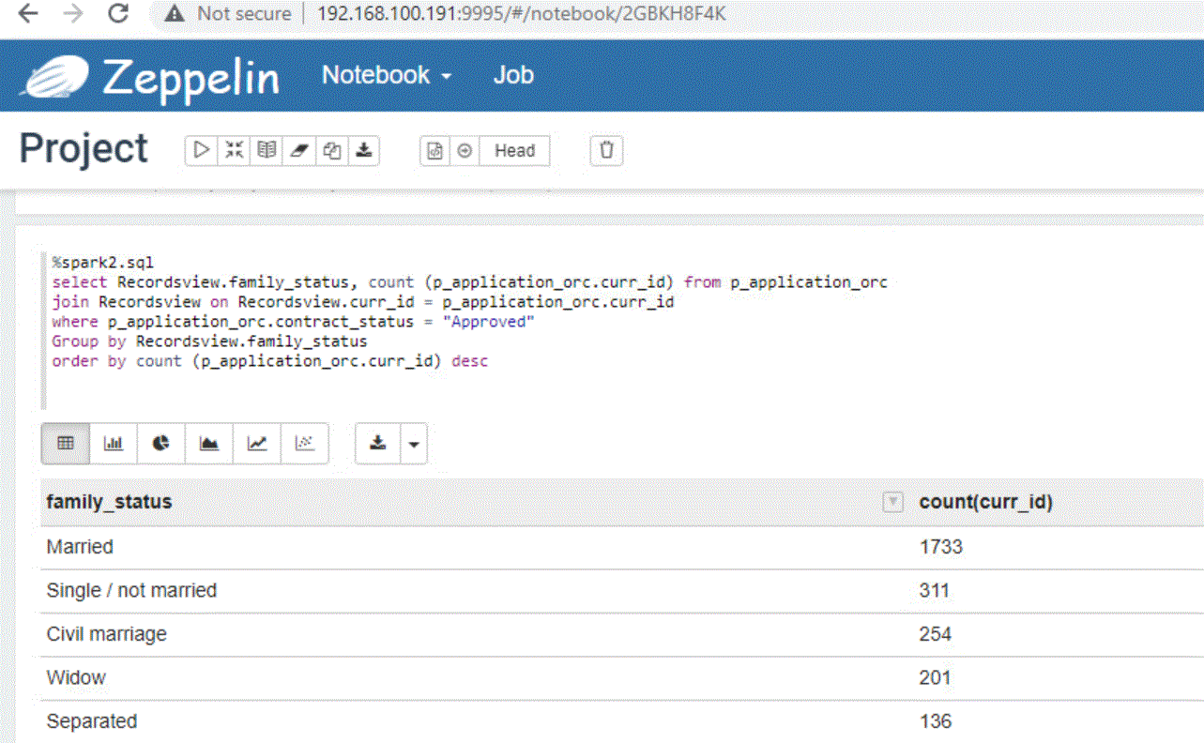
Which Family Status got the most loan approval?
Notes:
Married couples took the majority of family status to be approved for a loan with 1733 cases. We had visualized this on a pie chart below.

Slide 30
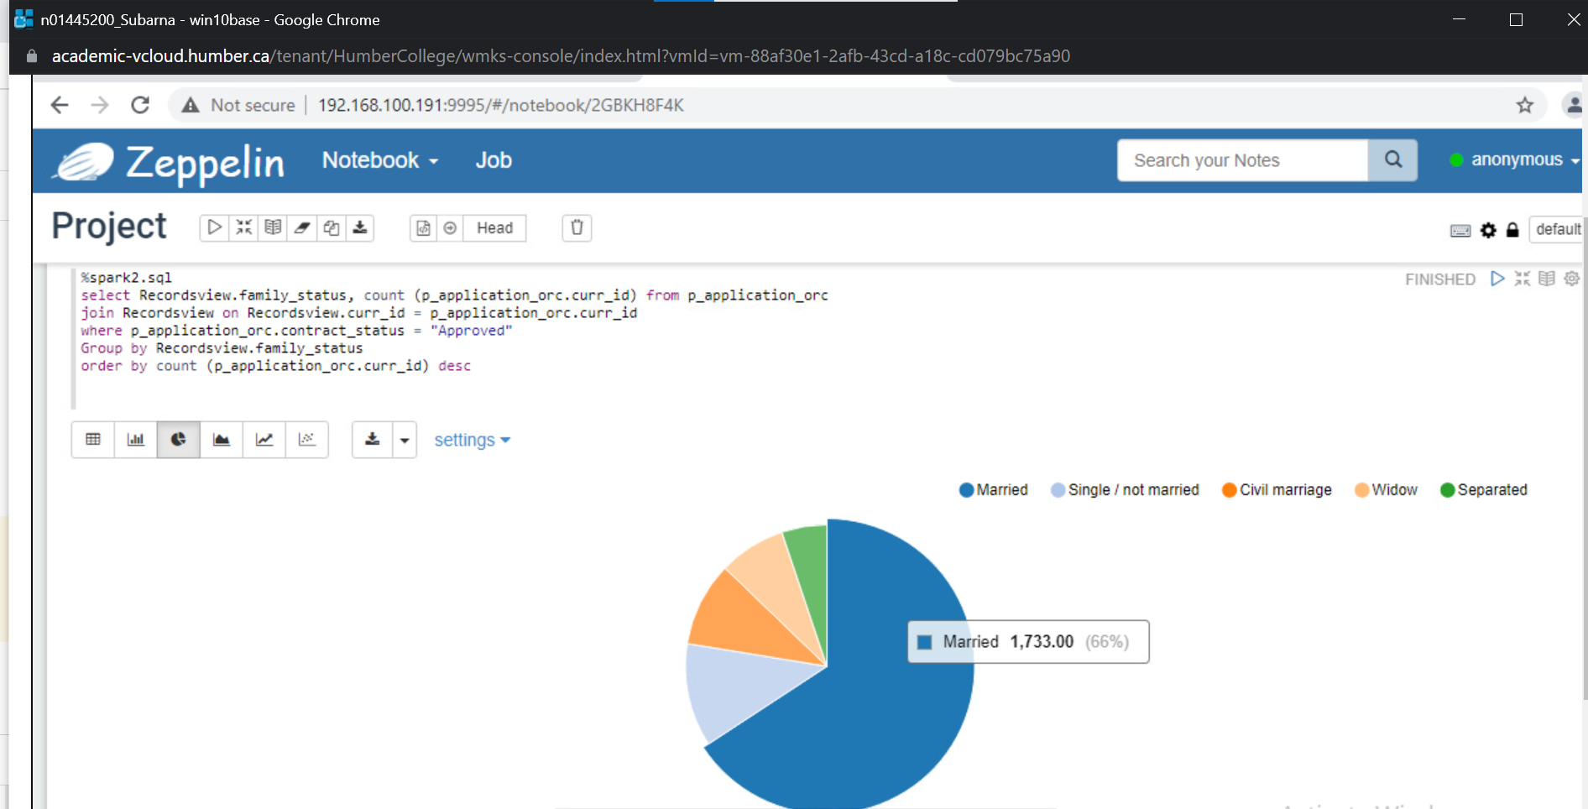
Family Status’s Pie chart
Notes:
Married customers played the most crucial in cases of application getting approval for loan by ⅔ of cases (1733 cases).
The second highest family status was single/not married but consisted of only 311 cases.

Slide 31
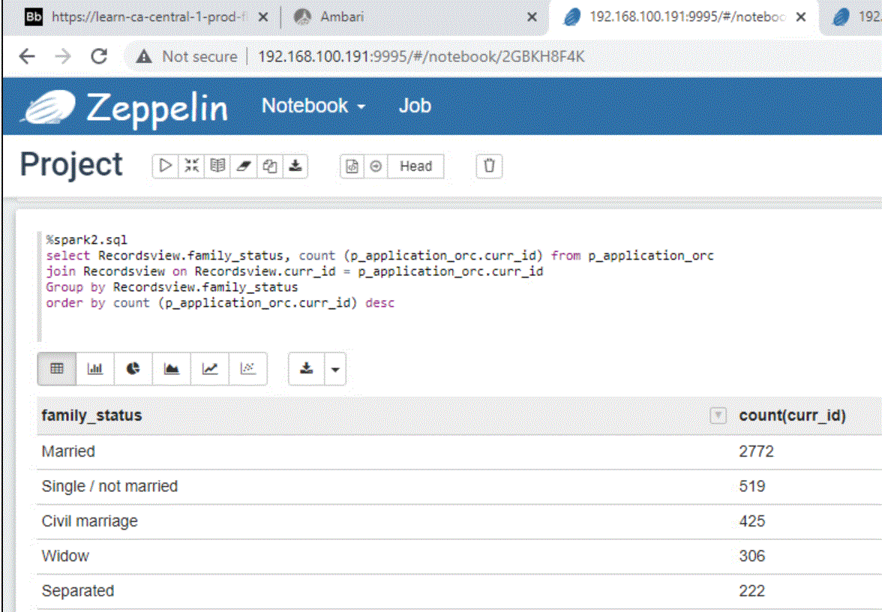
Loan application by family status
Notes:
Married people applied more loans than group of family status.

Slide 32
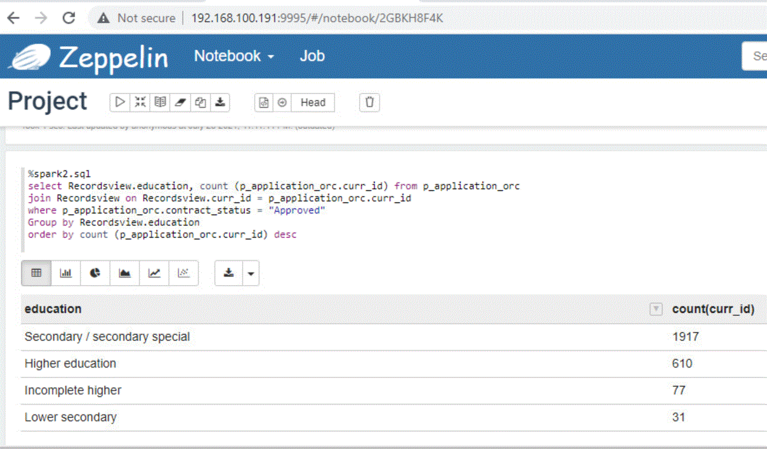
Which education type of applicants got the most loan approvals?
Notes:
Looking at the education background of applicant group getting the most loan approvals, secondary/secondary special played the most significant role in this field with the highest count by 1917 (73 %). Meanwhile, higher education came at the 2nd place with 610 cases (23%). Incomplete higher and Lower Secondary contributed minor figures of 3% and 1%, respectively.

Slide 33
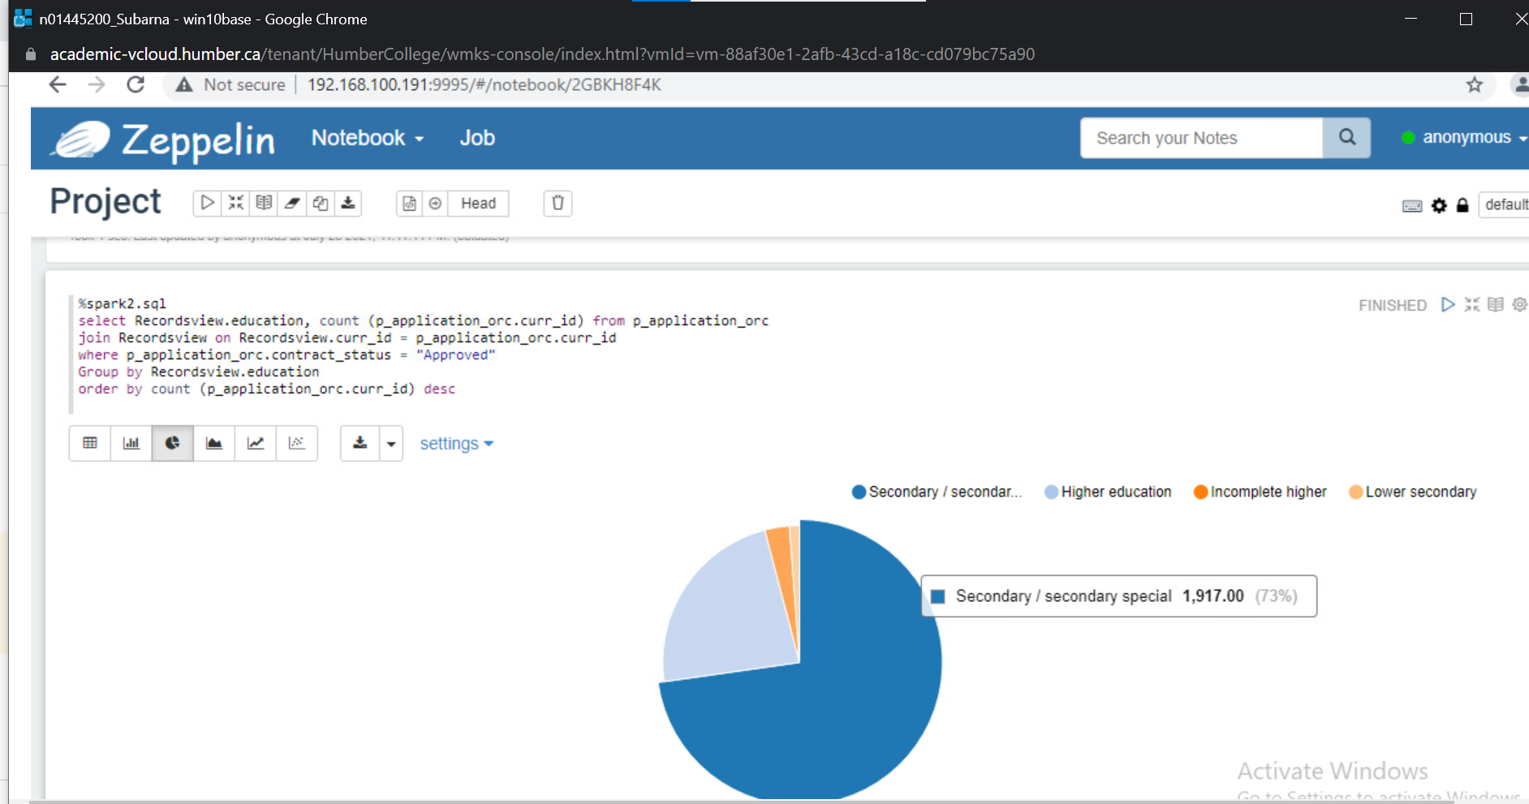
Which education type of applicants got the most loan approvals?
Notes:
Secondary/Secondary special took approximately ¾ of the pie chart. Educated applicants tends to get more loan approvals.

Slide 34
Final Conclusion
Most significant background check of applicants who got the most loan approvals:
Working Income Type
Married Family Status
Secondary/Special Secondary Education Type
Home Credit should:
Focus on Working income type, Married couples, Secondary/High school education background of applicants as the first priority and the main customer target
Secondary customer target should be Commercial Associates, Single/Not Married customers, High School
Notes:
Retired people have applied for loans though they own houses and have a sufficient income.
Working is the most significant income type of applicants who got approval for loan
Married couples is the majority of successful loan applicants
Secondary, high school is the major group of applicant receiving loan
Home Credit should:
Focus on Working income type, Married couples, Secondary/High school education background of applicants as the first priority and the main customer target.
Secondary customer target should be Commercial Associates, Single/Not Married customers, High School

Slide 35
Thank you for listening!
Presented by:
Tarun Kataria

